Slide 1
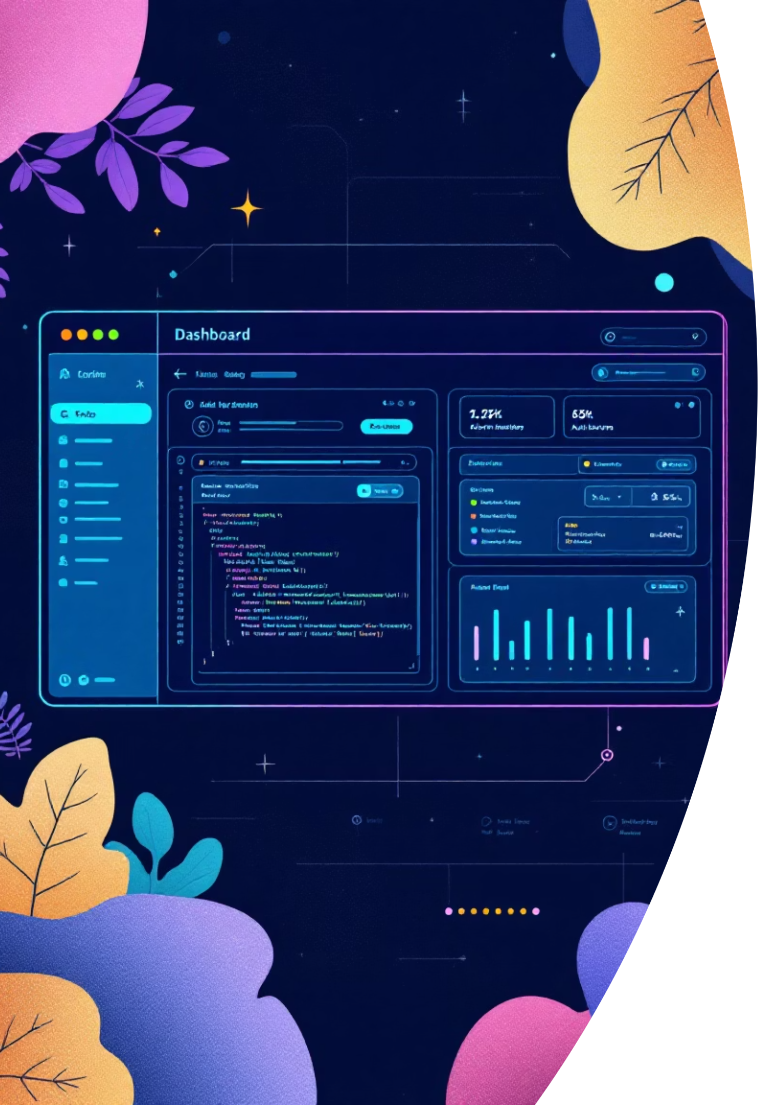
Playwright Framework
A comprehensive guide to building a robust test automation framework with TypeScript, Page Object Model, and advanced reporting capabilities.

Slide 2

Prerequisites & Setup
Node.js v16+
Visual Studio Code
JavaScript runtime environment with npm package manager included for dependency management.
Recommended IDE with excellent TypeScript support and debugging capabilities.
TypeScript Ready
Strong typing support for better code quality and enhanced development experience.

Slide 3

Project Initialization
01
02
03
Create Project Folder
Install Playwright
Add Dependencies
Set up your workspace and open in VS Code editor for development.
Run npm init playwright@latest and choose TypeScript as language.
Install csv-parse, xlsx, allure-playwright, and faker for enhanced functionality.
Choose "Yes" for browser installation and GitHub Actions workflow during setup.

Slide 4

Project Structure
Organized Architecture
tests/ - All test specification files
pages/ - Page Object Model classes
utils/ - Utility functions and helpers
data/ - Test data files (JSON, CSV)
reports/ - Generated test reports
Configuration files include playwright.config.ts and test.config.ts for comprehensive setup.

Slide 5
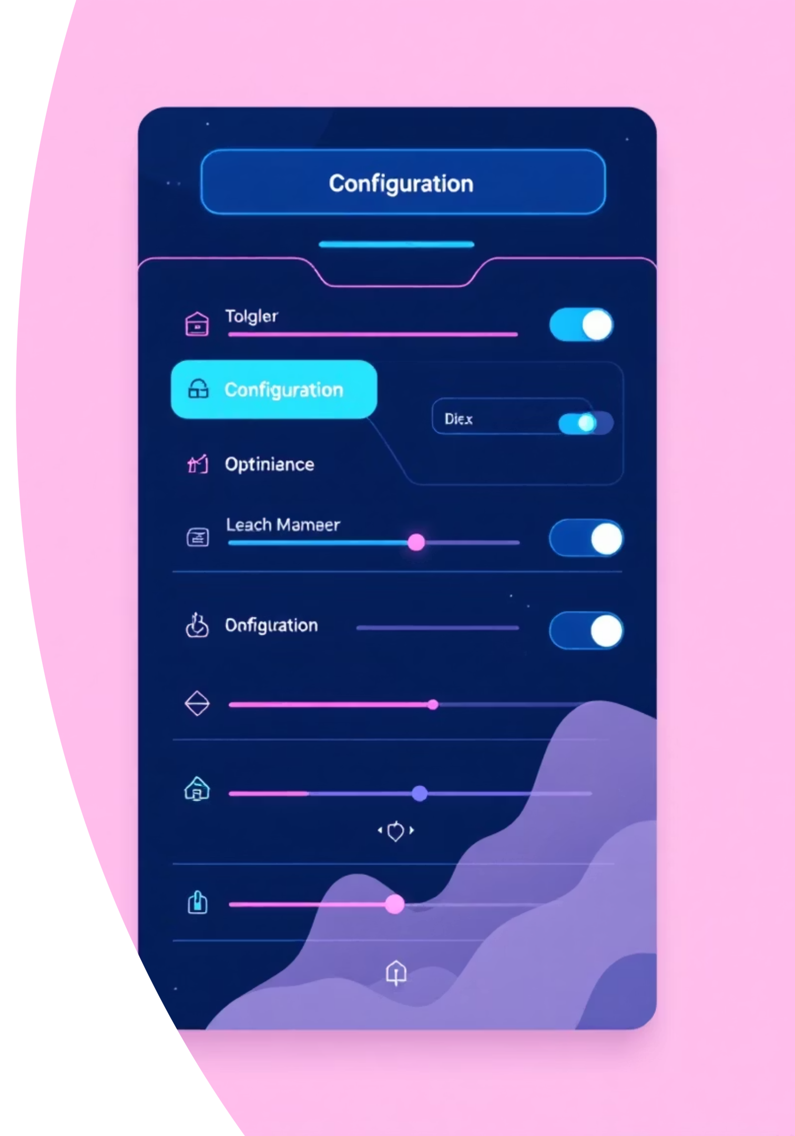
Configuration Setup
Playwright Config
30-second timeout, single worker, retry on failure, with HTML and Allure reporting enabled.
Test Config
Global test data including app URL, login credentials, and product details for reusability.
reporter: [ ['html'], ['allure-playwright'], ['dot'], ['list']]

Slide 6


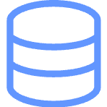
Page Object Model Implementation
Core Pages
E-commerce Pages
Data Management
HomePage, LoginPage, RegistrationPage, and MyAccountPage classes for user authentication flows.
ProductPage, SearchResultsPage, ShoppingCartPage, and CheckoutPage for shopping workflows.
JSON and CSV test data files with utility classes for data generation using Faker.

Slide 7
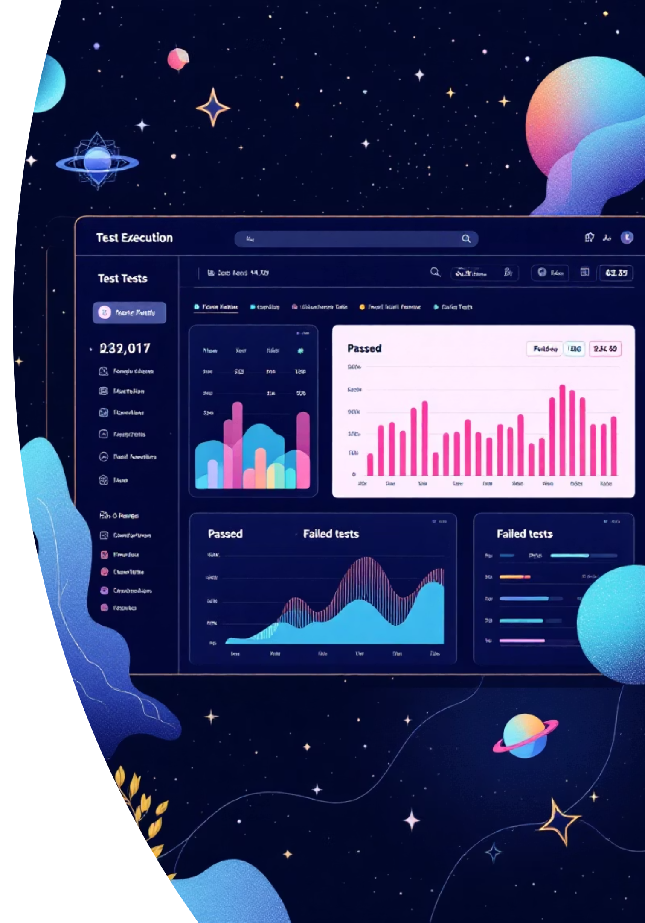
Test Execution & Reporting
1
Test Tagging
Organize tests with @master, @sanity, @regression, and @datadriven tags for targeted execution.
2
Custom Scripts
Package.json scripts for running specific test suites with headed or debug modes.
3
Report Generation
HTML and Allure reports with commands for generating and viewing detailed test results.

Slide 8

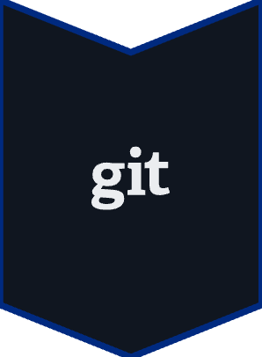

CI/CD Integration
Version Control
Commit project files to Git and push to GitHub repository for collaboration.
Jenkins Integration
Run local and GitHub projects with Jenkins Pipeline for automated testing workflows.
Configure parallel execution with workers: 4 and fullyParallel: true for faster test runs.

